Slide 1


What’s Trending? A Data-Driven Look at Social Buzz's Most Popular Posts

Slide 2


Today's agenda
Project recap
Problem
The Analytics team
Process
Insights
Summary

Slide 3

Client: Social Buzz
Founded by 2 Engineers who formerly worked in a large social media conglomerate.
Boasts over 500M+ monthly users with emphasis on keeping all users anonymous, only tracking user reactions on every piece of content.
Challenges:
Rapid growth
Generation of enormous, highly unstructured data
Unable to utilize current resources as 200 of 250 people work to manage and maintain the complex tech the app is built on.
Reasons for seeking External Expertise:
Guidance on IPO that is expected to be completed by the end of next year
Desire to seek help from an experienced practice
To understand data best practices from a large corporation
Project Recap

Slide 4

Problem
To Analyse their content and highlight the top 5 categories with the largest aggregate popularity

Slide 5



Andrew Fleming
Chief Technical Architect
The Analytics team
Marcus Rompton
Senior Principle
Myself
Data Analyst

Slide 6
Process
1 Requirement Gathering
2 Data Collection
3 Data Cleaning & Modeling
Data Analysis
5 Uncovering Insights

Slide 7

Insights
16
UNIQUE
CATEGORIES
1897
REACTIONS TO MOST POPULAR CATEGORY
JANUARY
MONTH WITH MOST POSTS

Slide 8
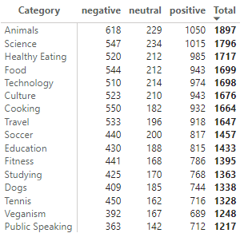
Insights
Sentiment Analysis: The overall response for content seems to be overwhelmingly positive across all types of content. The category of animals has more user engagement and is in the leading in all three of negative, neutral and positive reactions boasting a wide variety of user engagement.

Slide 9
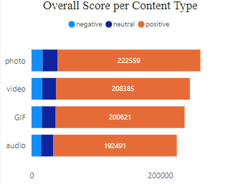
Content Type: Photos seem to be posted more than video, GIF and audio and they also seem to garner more positive reactions in comparison. Video follows the photos which is closely followed by GIFs and audio.

Slide 10
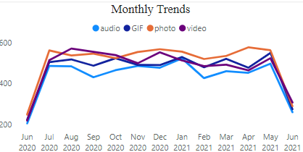
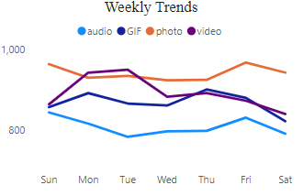
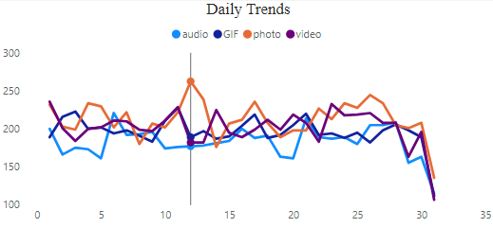
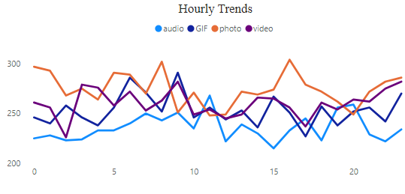
Posting Trends: The posting across hourly, daily, weekly, monthly and yearly trends show that the most type of content posted was photos and least was audio. GIF and video alternated between them. This seem to be the case across the categories and drives engagement by having similar reactions of all three sentiments.

Slide 11
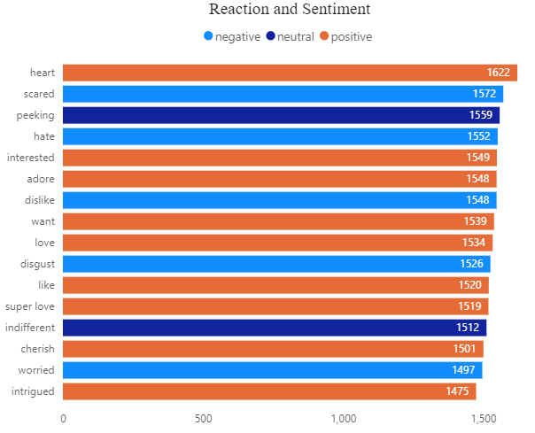
Insights
Reactions: There is a lot more types to positive reaction as compared to neutral and negative and Animals is among the top 5 across all reaction types among all sentiments.

Slide 12
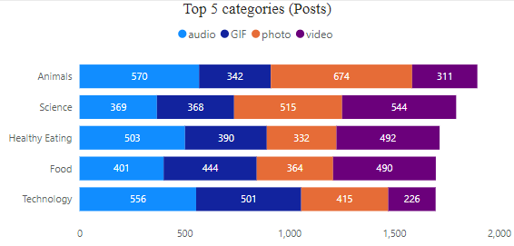
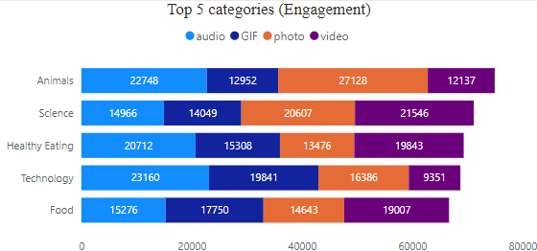
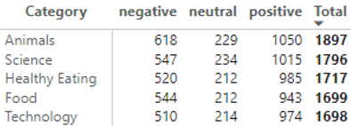
Top 5 categories: Animals, Science, Healthy eating, Food and Technology are the Top 5 categories that have most posts and engagement across all three sentiments. Animals seem to have most positive and most negative sentiments while Science tops the neutral game.

Slide 13
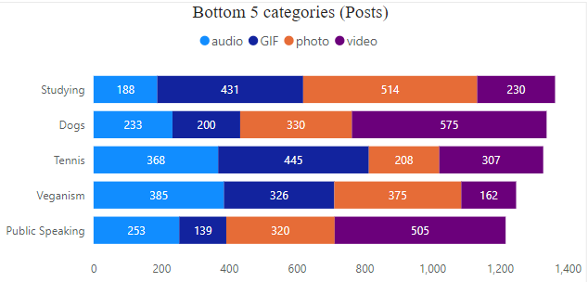
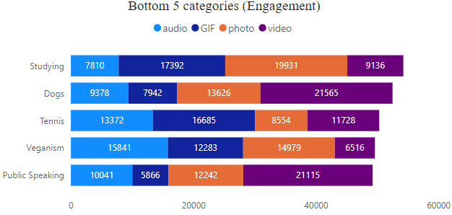
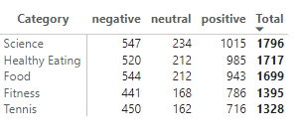
Bottom 5 categories: Contents on Public speaking, Veganism, Tennis, Dogs and Studying occupy the bottom 5 categories. The order is maintained across neutral and negative reactions and with positive reactions public speaking out does Veganism.

Slide 14

Sentiment and Engagement: Content, especially in the Animals category, garners high engagement across all sentiment types. To leverage this, consider applying successful strategies from this category (like visually appealing content) to improve engagement in underperforming areas like Public Speaking and Veganism.
Content Type Performance: Photos dominate both in volume and positive reactions, with videos following closely behind. To enhance engagement, continue prioritizing photo posts, especially in top-performing categories like Science and Healthy Eating, while also using more photo-based content in underperforming categories like Tennis.
Summary
Top and Bottom Categories: Animals, Science, Healthy Eating, Food, and Technology are the top five categories for engagement. Boost interest in the lower-performing categories (Public Speaking, Veganism, Tennis, Dogs, and Studying) by creating targeted campaigns with more interactive, visual content.

Slide 15
Thank you!
ANY QUESTIONS?

